Slide 1
Copyright
This material is owned by OutSystems and may only be used in the ways described in this Copyright Notice:
You may take temporary copies necessary to read this document
You may print a single copy of this material for personal use
You must not change any of this material or remove any part of any copyright notice
You must not distribute this material in any shape or form

Slide 2
Programming Model

Slide 3
Topics
Basic programming elements
Separated into layers
Web Screen lifecycle
Synchronous
Mobile Screen lifecycle
Asynchronous
Events & Handlers

Slide 4
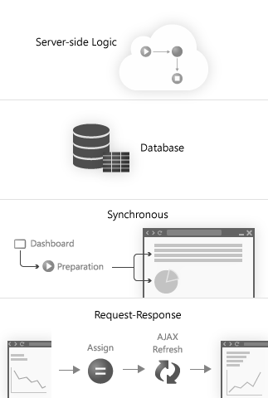
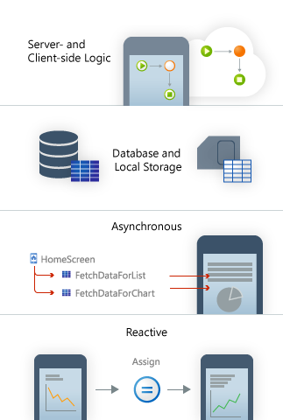
Mobile Apps
Web apps
Mobile Apps (NEW)
Web apps
Run logic on server
Store data on server
Fetch data synchronously
Request-response pattern
Mobile apps
Run logic on the device
Store data locally & on server
Fetch data asynchronously
React to changes immediately

Slide 5
Basic elements

Slide 6

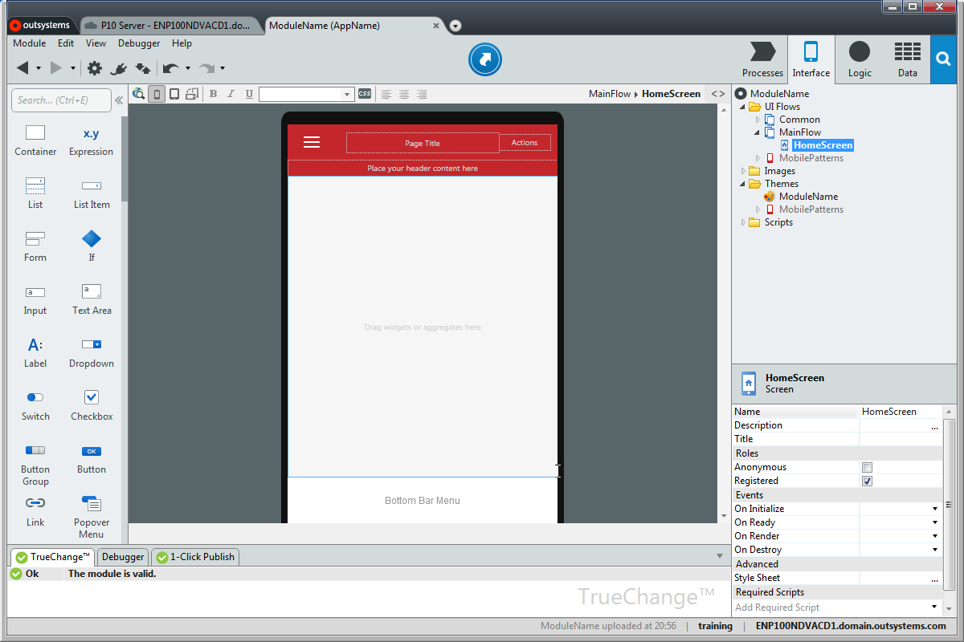

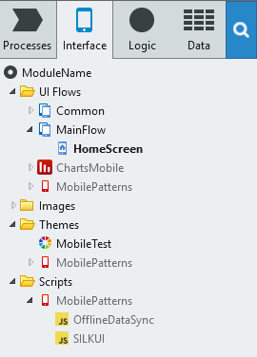
Interface Layer
UI Flows
Screens
Patterns
Images - graphics, icons, etc.
Themes - base look and feel
Scripts - javascript resources

Slide 7



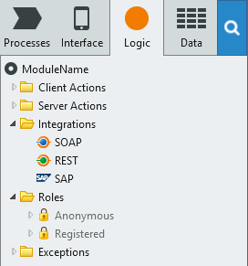
Logic layer
Client Actions - run on device
Server Actions - run on server
Integrations
SOAP - Web Services
REST - RESTful Services
SAP - SAP connector/integration
Roles - security roles
Anonymous & Registered
Exceptions

Slide 8

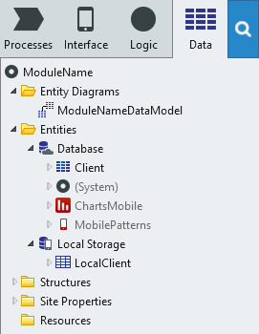
Data layer
Entity diagrams
Entities - persistent storage
Database - server side
Local Storage - on device storage
Structures - in memory data
Site properties - cross app data
Resources - other data

Slide 9
Web Screen lifecycle

Slide 10

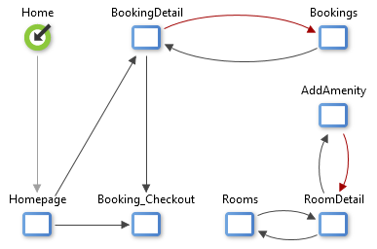
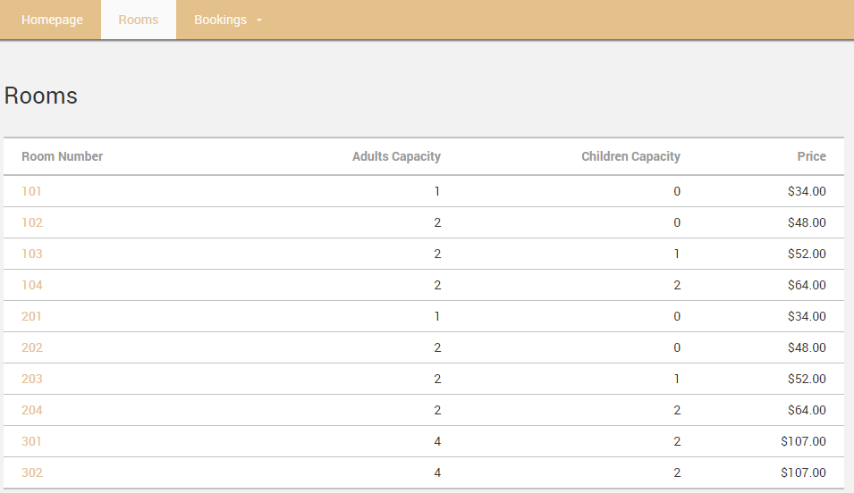
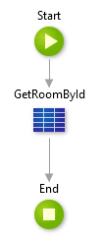
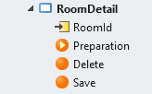
Web App
Server
HTTP GET RoomDetail
DB

Slide 11
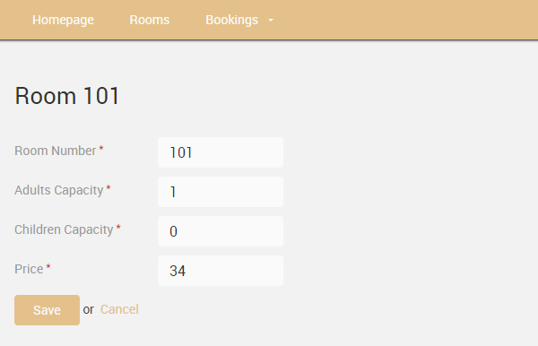
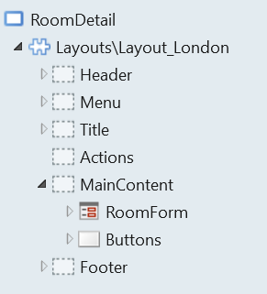
Web App
Server
HTTP GET RoomDetail
HTML + viewstate
Rendered
HTML & Data
HTTP GET
CSS, JS, IMG
Page Resources

Slide 12
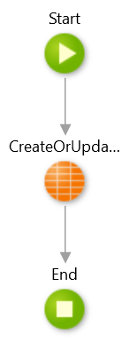
Web App
Server
HTTP GET RoomDetail
HTTP POST RoomDetail
DB

Slide 13
Mobile Screen lifecycle

Slide 14
Mobile apps are SPAs
OutSystems 10’s compiler generates JavaScript for the Screen logic
Screen logic runs on the client side
JavaScript generates the HTML for each Screen
Server logic is still .NET or Java code
Data will be requested as needed (asynchronous Actions)
OutSystems generates REST endpoints for Aggregates or data fetch Action
Asynchronous Actions do not block the rendering of the Screen
Multiple requests can be in flight at the same time
Logic in the Screens is now specified in Client Actions

Slide 15
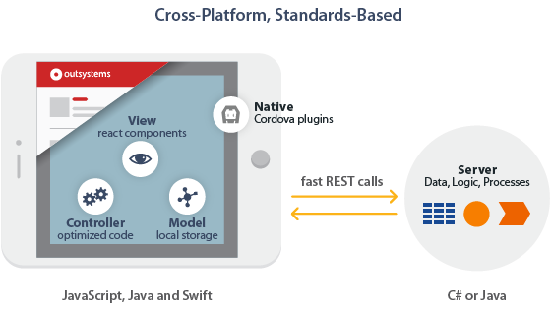
New runtime architecture

Slide 16
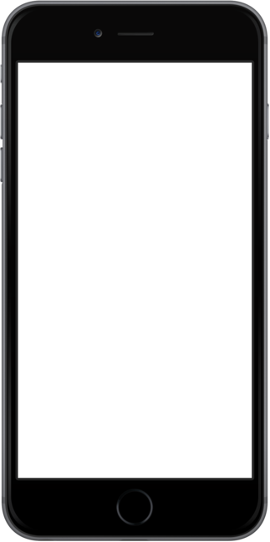
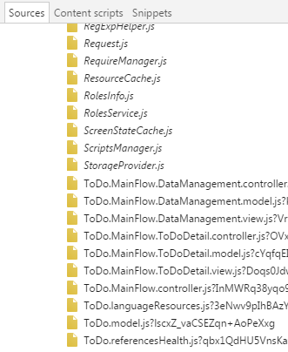
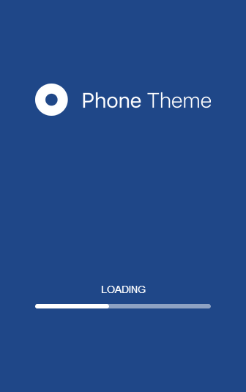
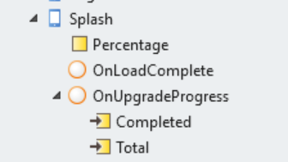
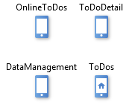
Splash screen

Slide 17
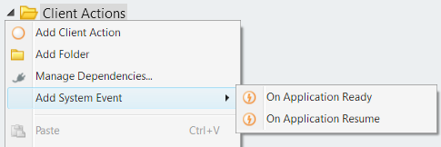
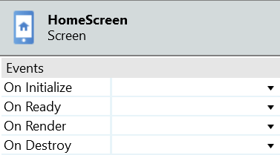
App & Screen Events
Events to signal changes
Share data about change
Handlers to react to changes
App Events
On Application Ready
On Application Resume
Screen Lifecycle Events
OnInitialize
OnReady
OnRender
OnDestroy

Slide 18
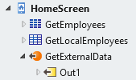
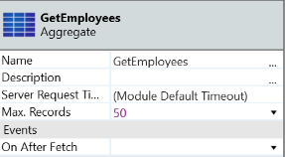
Data fetching
Data fetching
Aggregates in the Screen
Database or Local Storage Entities
Data Action for advanced cases
Output Parameters must be Assigned inside the Action
Data Type by default is Text, but can be changed
Performed asynchronously
Performed in parallel
Screen Lifecycle Event
On After Fetch

Slide 19
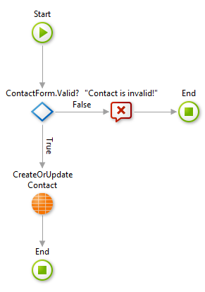
Client-side logic
Responsiveness
UI elements react to data changes
Updates occur immediately
Virtualization mechanism
Renders only displayed item
UI responds while calling server
Client Actions
Visually modeled logic and data
Easy to call server-side logic
Drag & drop server actions
REST API generated automatically
Calls are asynchronous

Slide 20
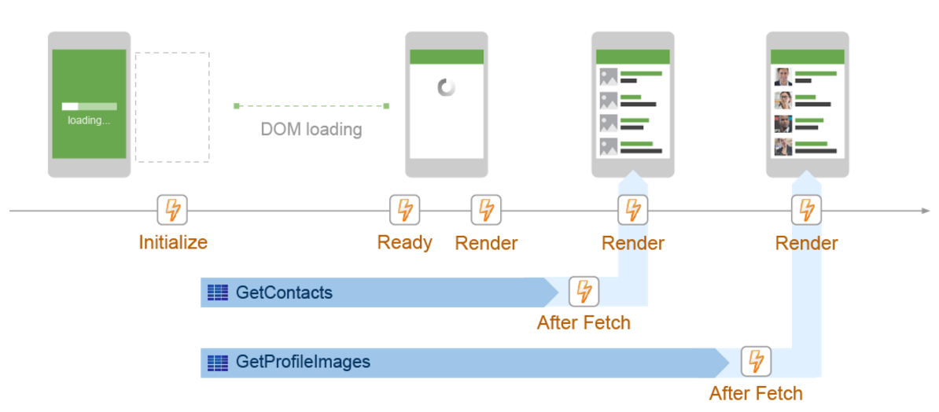
Opening the app (loading the Screen)
Notes:
Initialize: assign some defaults and variables.

Slide 21
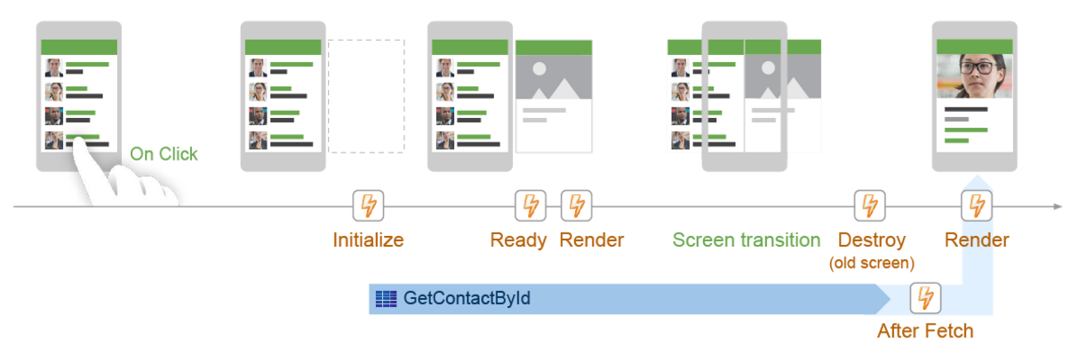
Navigating between Screens
Notes:
Note: A system function, ScreenReachedFromHistory() is true when you go into a screen by pressing back

Slide 22
Lifecycle Event Handlers
On Initialize | Occurs after checking the permission of the user to access the Screen, but before navigating to the Screen and fetching data. You can use it to initialize the Screen, by setting its default data.
On Ready | Occurs after the Screen DOM is ready. You can use it to manipulate the DOM.
On Render | Occurs right after the Screen On Ready Event handler and every time the data of a Screen changes. You can use it to update some third-party component.
On Destroy | Occurs before destroying a Screen and removing it from the DOM. You can use it to implement logic when the component is disposed.
On After Fetch | Occurs after an Aggregate or Data Action has finished fetching data, but before the data is rendered on the Screen. You can use it to act upon the retrieved data.
Notes:
https://success.outsystems.com/Documentation/10/Developing_an_Application/Implement_Application_Logic/Screen_and_Block_Lifecycle_Events?origin=d#Lifecycle_Event_Handlers
OnParametersChanged will be covered in the Blocks. This will be revisited as well in that slide deck.

Slide 23
Summary
Basic programming elements
Separated into layers
Web Screen lifecycle
Synchronous
Mobile Screen lifecycle
Asynchronous
Events & Handlers

Slide 24

Programming Model

